Slide 1
Ascending and Descending venography
Student Name
Institution Affiliation

Slide 2
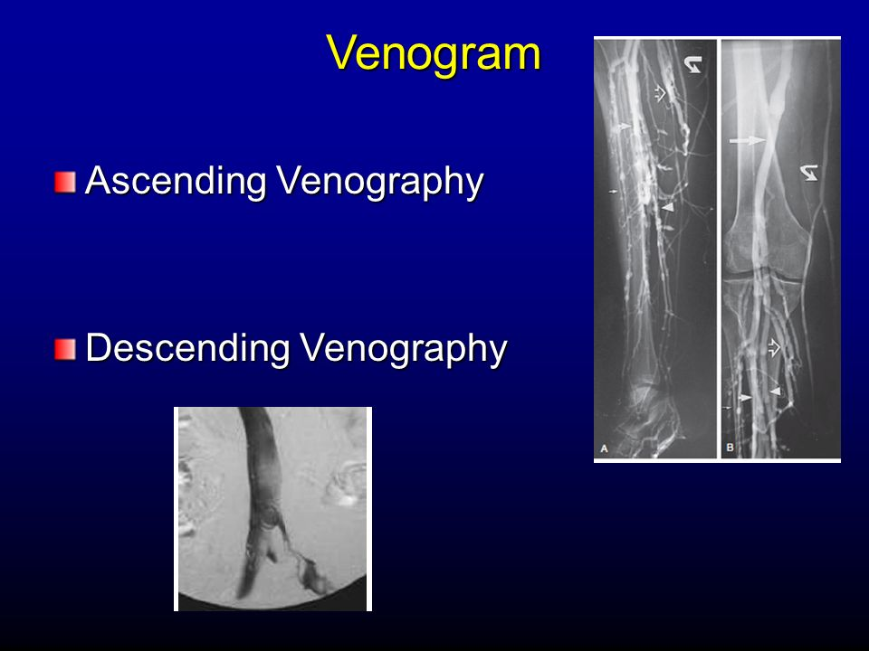
Introduction
Venogram is a test that allows the medical professional to see the veins in the body of the patient especially in the legs.
Ascending venography precisely looks for a DVT and finds out where it is in the patient veins.
Descending venography looks at how well the patient vein valves are.

Slide 3
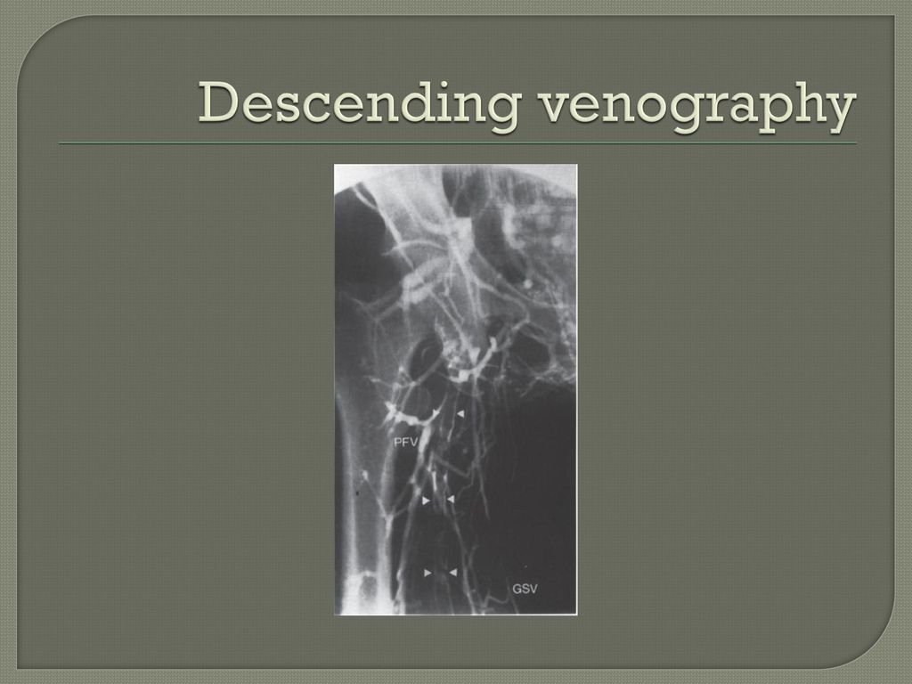
Use of the Procedure
Used to find blood clots
Used in identifying a vein to be utilized in a bypass procedure and dialysis access.
Used to asses varicose veins before surgery.
Used to asses the status of a vein
Used as guidance of treatment of diseased veins

Slide 4
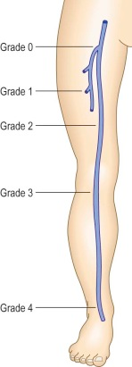
Why patient needs Venography
Venography is used to confirm a diagnosis of DVT.
The procedure can be used to look at vein problem present at birth.
The procedure is needed to look into the causes of swelling or pain in a leg.

Slide 5
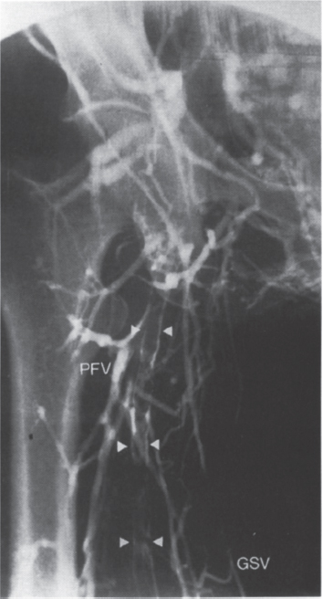
Information needed by Doctor before venography
Pregnancy
Recent illnesses
Medical conditions
Medications being taken currently
Allergies

Slide 6
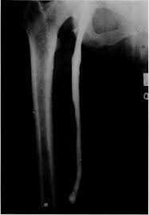
What to know before Agreeing to the Procedure
The name of the procedure
Reason of having the procedure
Results expected and what they mean
Risk and benefits of the procedure
Possible side effects of procedure
When and where one will have the procedure
Who will do the procedure and their qualifications

Slide 7
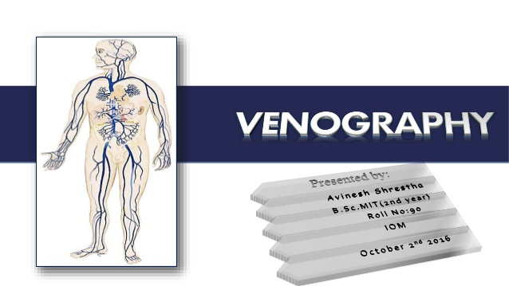
What to know before Agreeing to the Procedure Cont'd
What would have happened if the procedure was not done
Any alternative procedures to think about
When and how one will get the results
Who to call after the procedure incase on has questions
The total cost of the procedure

Slide 8
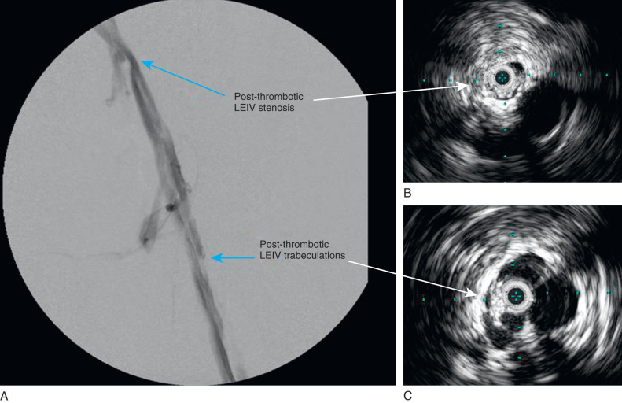
Preparation for the Procedure
Do not take medications several hours before the procedure
Do not eat or drink anything several hours before the procedure
Drink some clear liquids on the procedure day

Slide 9
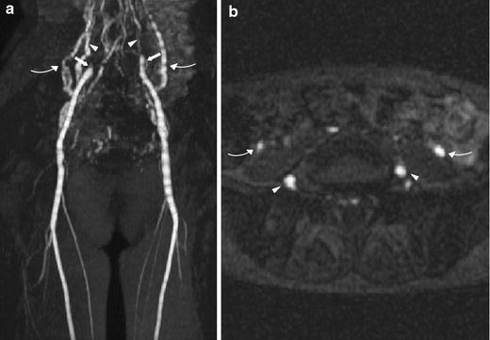
Equipment Used for the Procedure
The procedure equipment consists of;
A radiographic table
One or two x-ray tubes
A television-like monitor located in the examining room

Slide 10
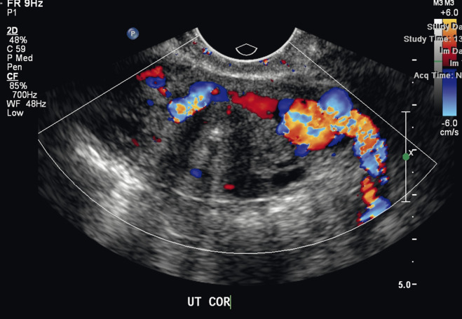
Equipment Used for the Procedure Cont'd
Fluoroscopy – Coverts x-rays into video images and used to watch and guide progress of procedure.
An intravenous line.
Ultrasound machine
Devices monitoring blood pressure and heart beat.

Slide 11
Working of the Procedure
Once it is carefully aimed at the part of the body being examined, an x-ray machine produces a small burst of radiation that passes through the body, recording an image on photographic film or a special detector.
X-rays are absorbed by different parts of the body in different degrees.
Soft tissues such as fats allows more x-rays to pass through them.
Dense bone absorbs more of the radiations (Johns Hopkins Medicine, n.d.).

Slide 12
Working of the Procedure Cont'd
Due to different rates of radiation exposure, bones appear white on the x-rays.
Soft tissues shows up in shades of gray and air appears black
Veins cannot be seen on an x-ray.
Through the IV line, Iodine-based contrasts materials are injected into the veins to make them visible on x-rays (Bjarnason, 2017).

Slide 13
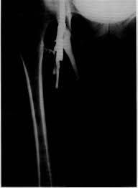
Performing the Procedure
The procedure is done on an outpatient basis
The procedure is done in the healthcare facility x-ray department
The procedure sometime is done in an interventional radiology suite (special procedures suite).

Slide 14
Performing the Procedure Cont'd
The patient lies on an x-ray table
The table is situated to a standing position depending on the part of the body.
The patient is secured with safety straps if the table is repositioned during the procedure.
The physician inserts a needle into the vein to inject the contrast agent.
The patient is moved in different positions to allow precise taking of x-ray pictures (Gabriel, Shiu & Ruehm, 2016).

Slide 15
Patient Experience during the Procedure
Patient removes some clothes and wears gown during the procedure
Patient removes all jewelry, removable dental appliances, eye-glasses and other mental objects and clothing which might interfere wit the x-ray images.
Patient feels slight pinch when needle is inserted into the vein.
Patient may feel pressure when the catheter is inserted into the vein.
All through the procedure, the patient does not feel serious discomfort (Radiological Society of North America (RSNA) and American College of Radiology (ACR)).

Slide 16
Patient Experience during the Procedure Cont'd
The patients feels warm when the contrast materials passes through the body.
Patient may feel mental taste in the mouth.
The leg or arm may feel as if they are getting numb.
The patient is asked to hold breathing for some minute to reduce the possibility of blurred images when the x-ray is being taken.
The x-ray machine is activated from another room

Slide 17
Patient Experience during the Procedure Cont'd
The patient is asked to wait until the radiologist determines that all the necessary images have been obtained.
The procedure take between 30 and 45 minutes to complete
To remove contrast materials from patient veins, fluids are run through the patient IV
The patient is instructed to drink a lot of drinks the following day after procedure
Observation of any sign of complications such as bleeding is made after completion of the procedure

Slide 18
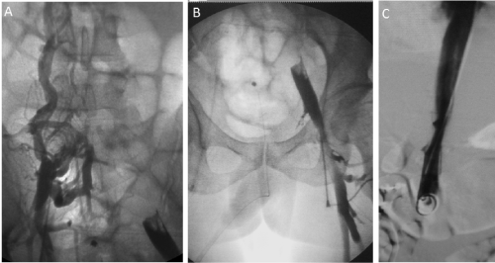
Procedure Results interpretation
The images are analyzed by a trained physician and radiologist
The radiologist or the physician will send a signed report to the patient primary care or the referring physician.
The primary care will there after discuss the results with the patient

Slide 19
Procedure Results interpretation Cont'd
After the procedure, follow-up exams are needed
The doctor has to explain why the need of the follow-up exams
A follow up exam is done due to potential abnormality.
Follow up exam is also needed to see if there has been any change in an abnormality over time.
Follow up exams are the best way to see if treatment is working or if an abnormality is stable or has changed.

Slide 20
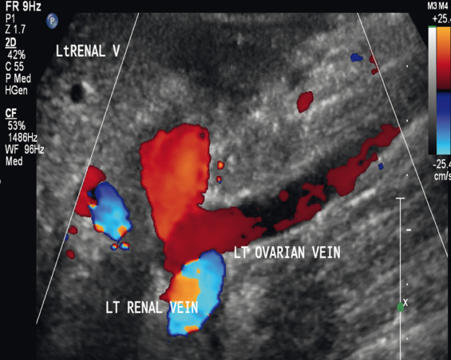
Procedure Potential Risks
Allergic reaction if contrast material is injected
The procedure can cause deep vein thrombosis
Risk of kidneys injury with contrast injection

Slide 21
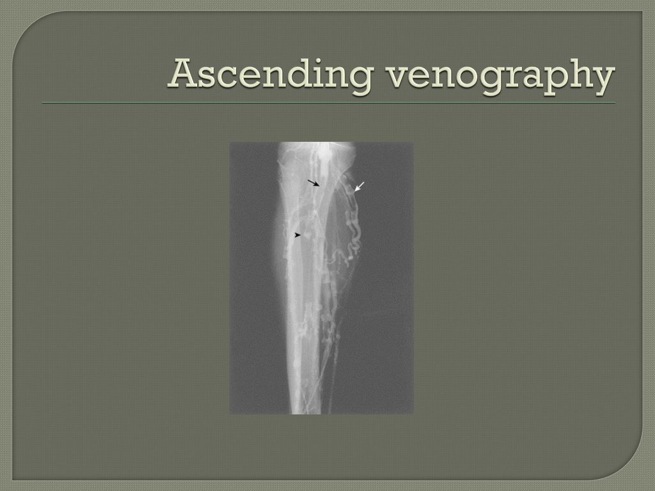
Procedure Potential Risks Cont'd
Risk of blood vessel damage
Risk of bleeding at the puncture site
Risk of vessel infection
Risk of cancer from excessive radiation exposure

Slide 22
Minimizing Radiation Exposure
Care is taken during procedure to use lowest radiation dose possible while producing the best images for evaluation.
National and international radiology protection organizations continually review and update the technique standards used by radiology professionals.
Modern x-ray systems have very controlled x-ray beams and dose control methods to minimize stray (scatter) radiation. This ensures that those parts of a patient's body not being imaged receive minimal radiation exposure.

Slide 23
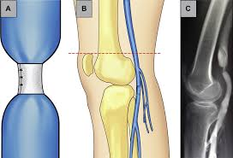
What makes procedure Less Accurate
Extreme Obesity
Severe swelling in the leg or arm
Constant movement of leg or arm during procedure

Slide 24
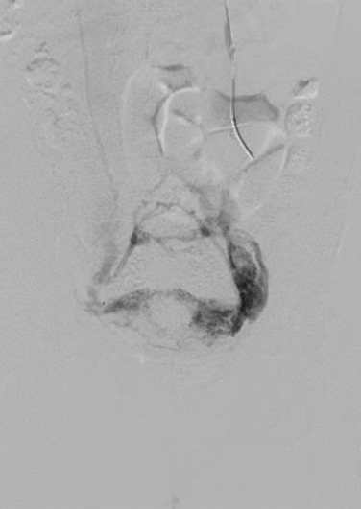
Effects of Procedure
A patient should call the healthcare provider immediately he or she experiences the following after the procedure;
Fever of 100.4°F (38.0°C) or higher or chills
Bleeding or other drainage from the injection site
Pain, redness, or swelling at the injection site

Slide 25
Limitations of Venography
Results of the procedure can be altered if patient is unable to sit still during the procedure since the movement will impact contrast material moves in the patient veins.
Exams may further be required to reinforce the procedure is more central veins are located in the chest, abdomen and pelvis.
In most cases, Ultrasound is proffered procedure since it has fewer risks and side effects (Johns Hopkins Medicine, n.d.).

Slide 26
References
Johns Hopkins Medicine. (n.d.). Venogram. Retrieved from https://www.hopkinsmedicine.org/health/treatment-tests-and-therapies/venogram
Radiological Society of North America (RSNA) and American College of Radiology (ACR). (n.d.). Venography. Retrieved from https://www.radiologyinfo.org/en/info.cfm?pg=venography
Bjarnason, H. (2017). Direct contrast venography. In Handbook of Venous and Lymphatic Disorders (pp. 169-176). CRC Press.
Gabriel, S., Shiu, C. K., & Ruehm, S. G. (2016). Magnetic Resonance Venography. In Imaging of the Cardiovascular System, Thorax, and Abdomen (pp. 135-156). CRC Press.

